Slide 1


Sensitivity of Soil Water Holding Capacity to Methods of Spatial Interpolation
Michael Felzan

Slide 2
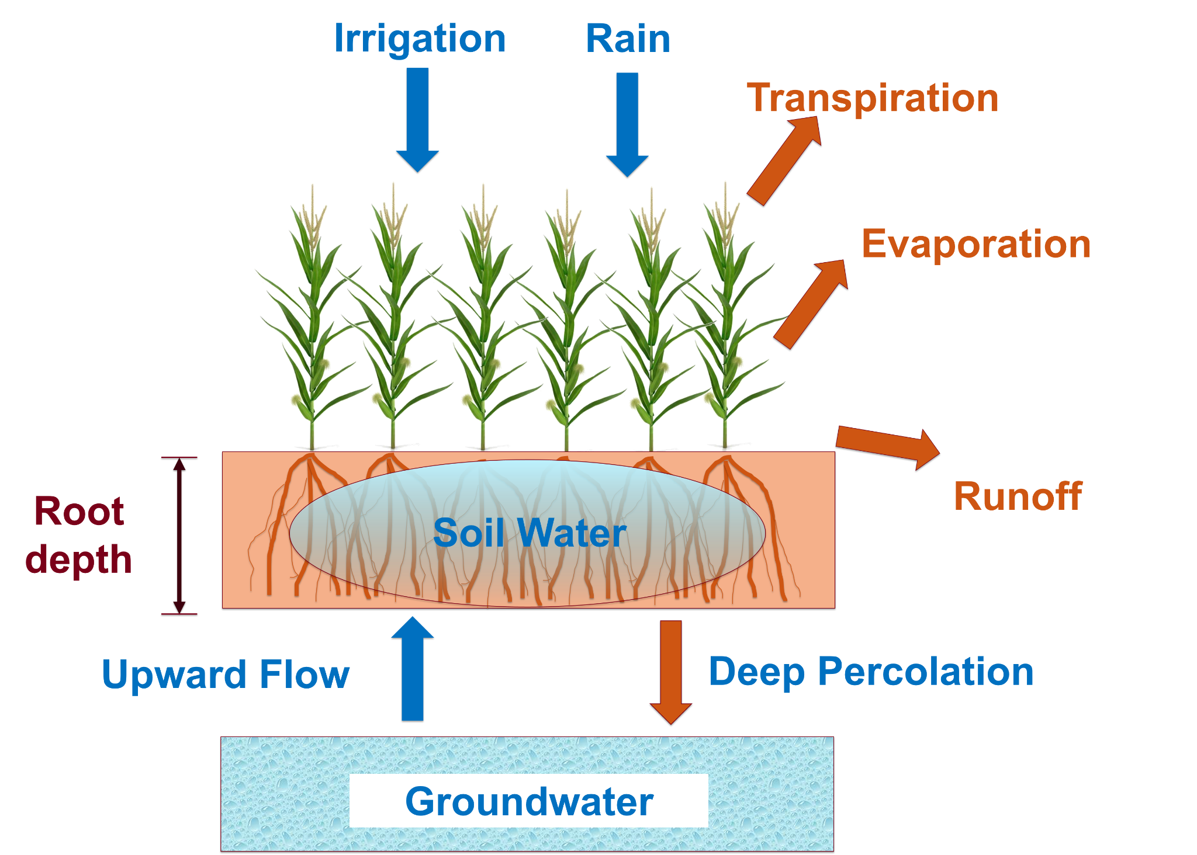
Background: Irrigation
Notes:
Irrigation involves applying the optimal amount of water to a crop field
Different crops have different root depths and abilities and tolerances for water. Irrigation amounts are adjusted for different crop types
If we think of soil water as a bucket, there are many variables acting as water inputs and outputs to//from that bucket

Slide 3
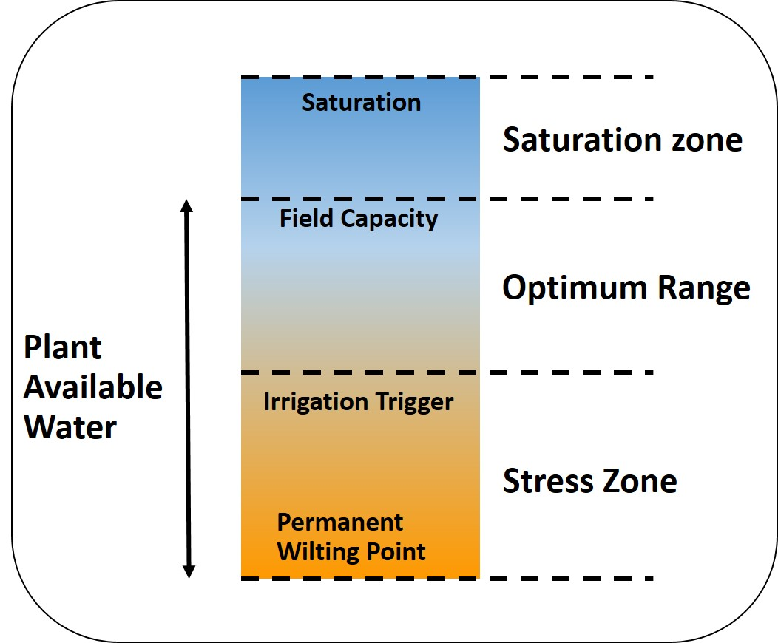
Background: Irrigation
The goal of irrigation is to keep soil water levels in the optimal range. This range is between:
The point of crops becoming ‘stressed’ due to not enough water
The field’s point of saturation where any additional water will be wasted, field can’t hold any more
The work of the LCCMR Irrigation Management Assistant project is to approximate the levels of irrigation that should be applied to a field throughout a growing season.

Slide 4
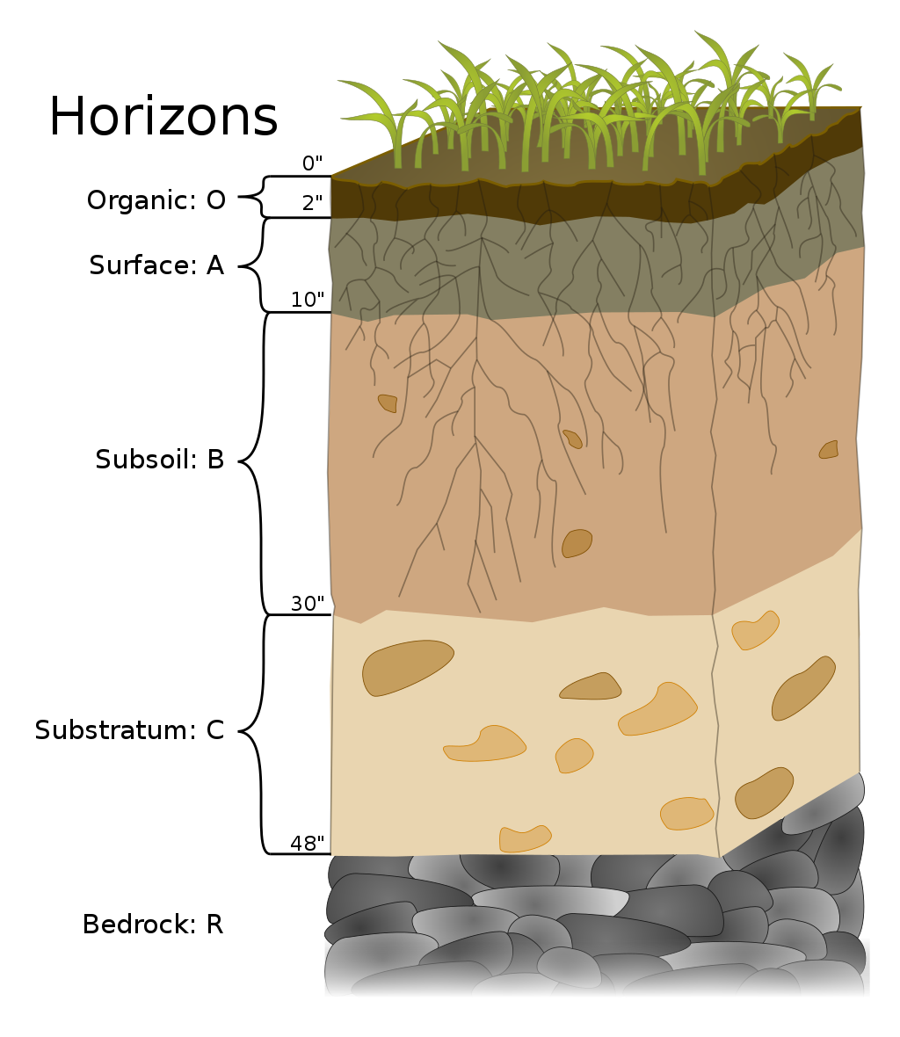
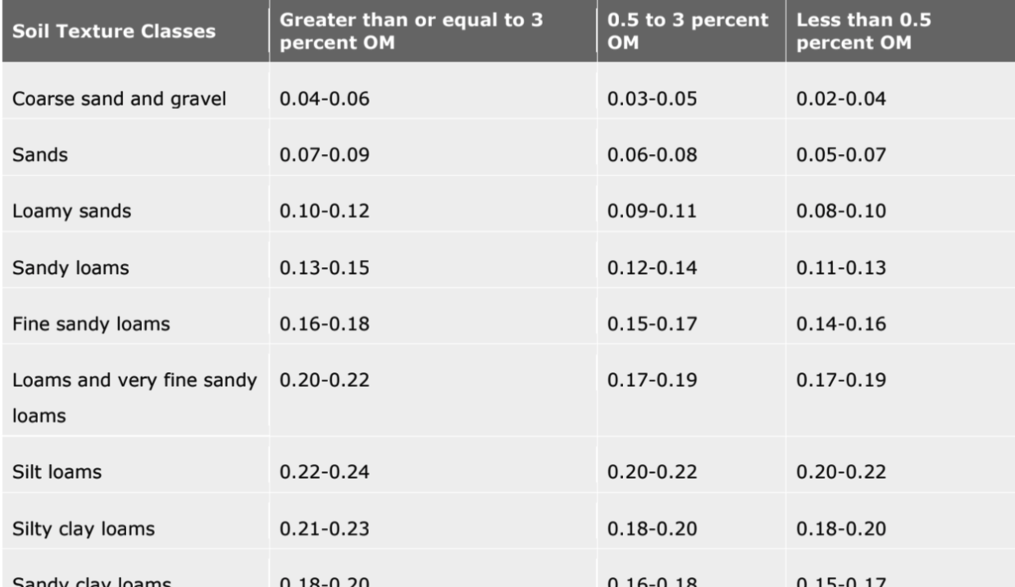
Background: Soil
Available Water Capacities in Centimeters per cm of Soil
Notes:
-Soils are conventionally broken down into discrete horizons, based on soil composition
-Horizons are not always at same depth intervals

Slide 5
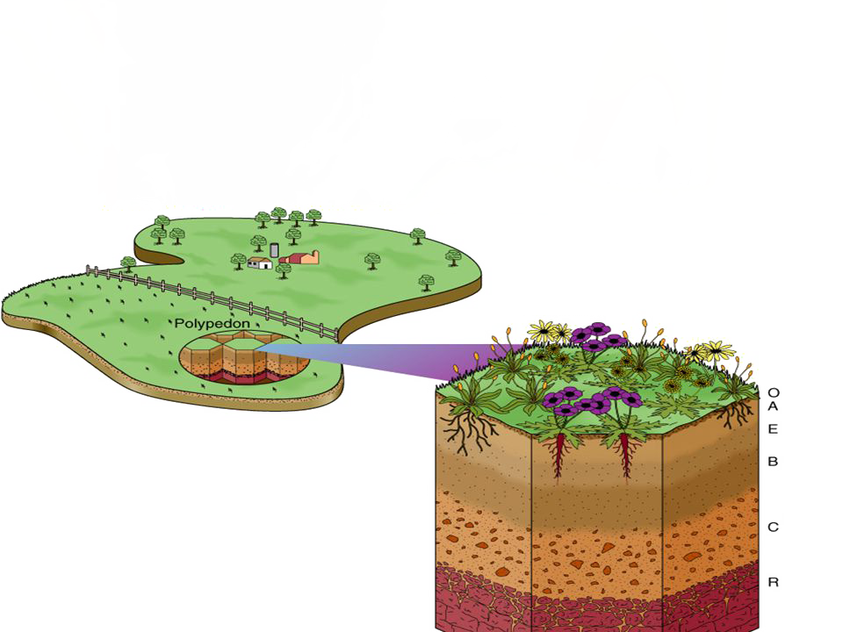
Background: Soil
Many horizons within a single pedon (3-D vertical soil unit)
Soil series are made up of pedons of similar characteristics and arrangement in soil profile
Components are generally phases of soil series that enable the most precise interpretation.
Soil Series
Horizons
Pedon

Slide 6

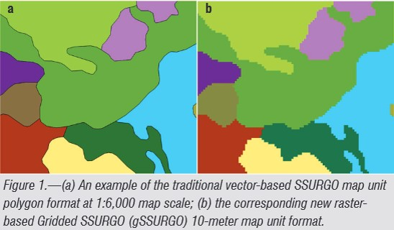
SSURGO Dataset
Soil Survey Geographic (SSURGO) Database
Available via USDA-NRCS (Natural Resources Conservation Service)
Highly detailed tabular soil data
Data developed by the National Cooperative Soil Survey (NCSS)
Data represents soil attributes, derived from National Soil Information System (NASIS)
“Gridded SSURGO” (gSSURGO) is similar to standard USDA-NRCS SSURGO Database product but in the format of an ESRI® file geodatabase
Contains data in raster format
gSSURGO Database

Slide 7
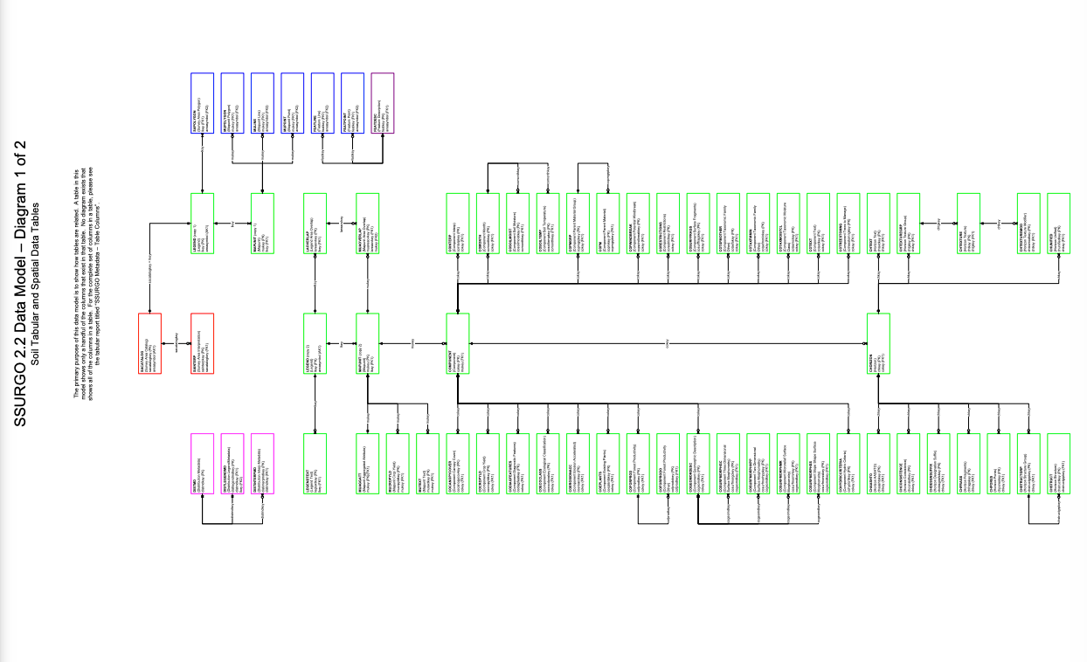

Slide 8
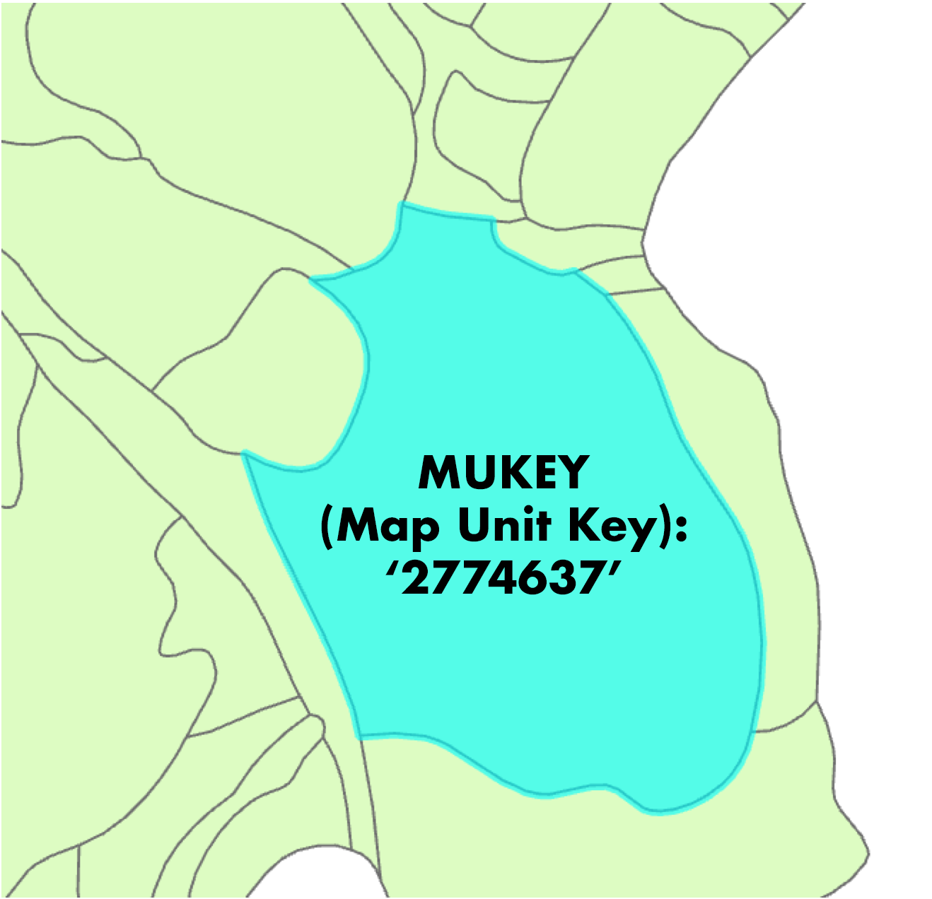
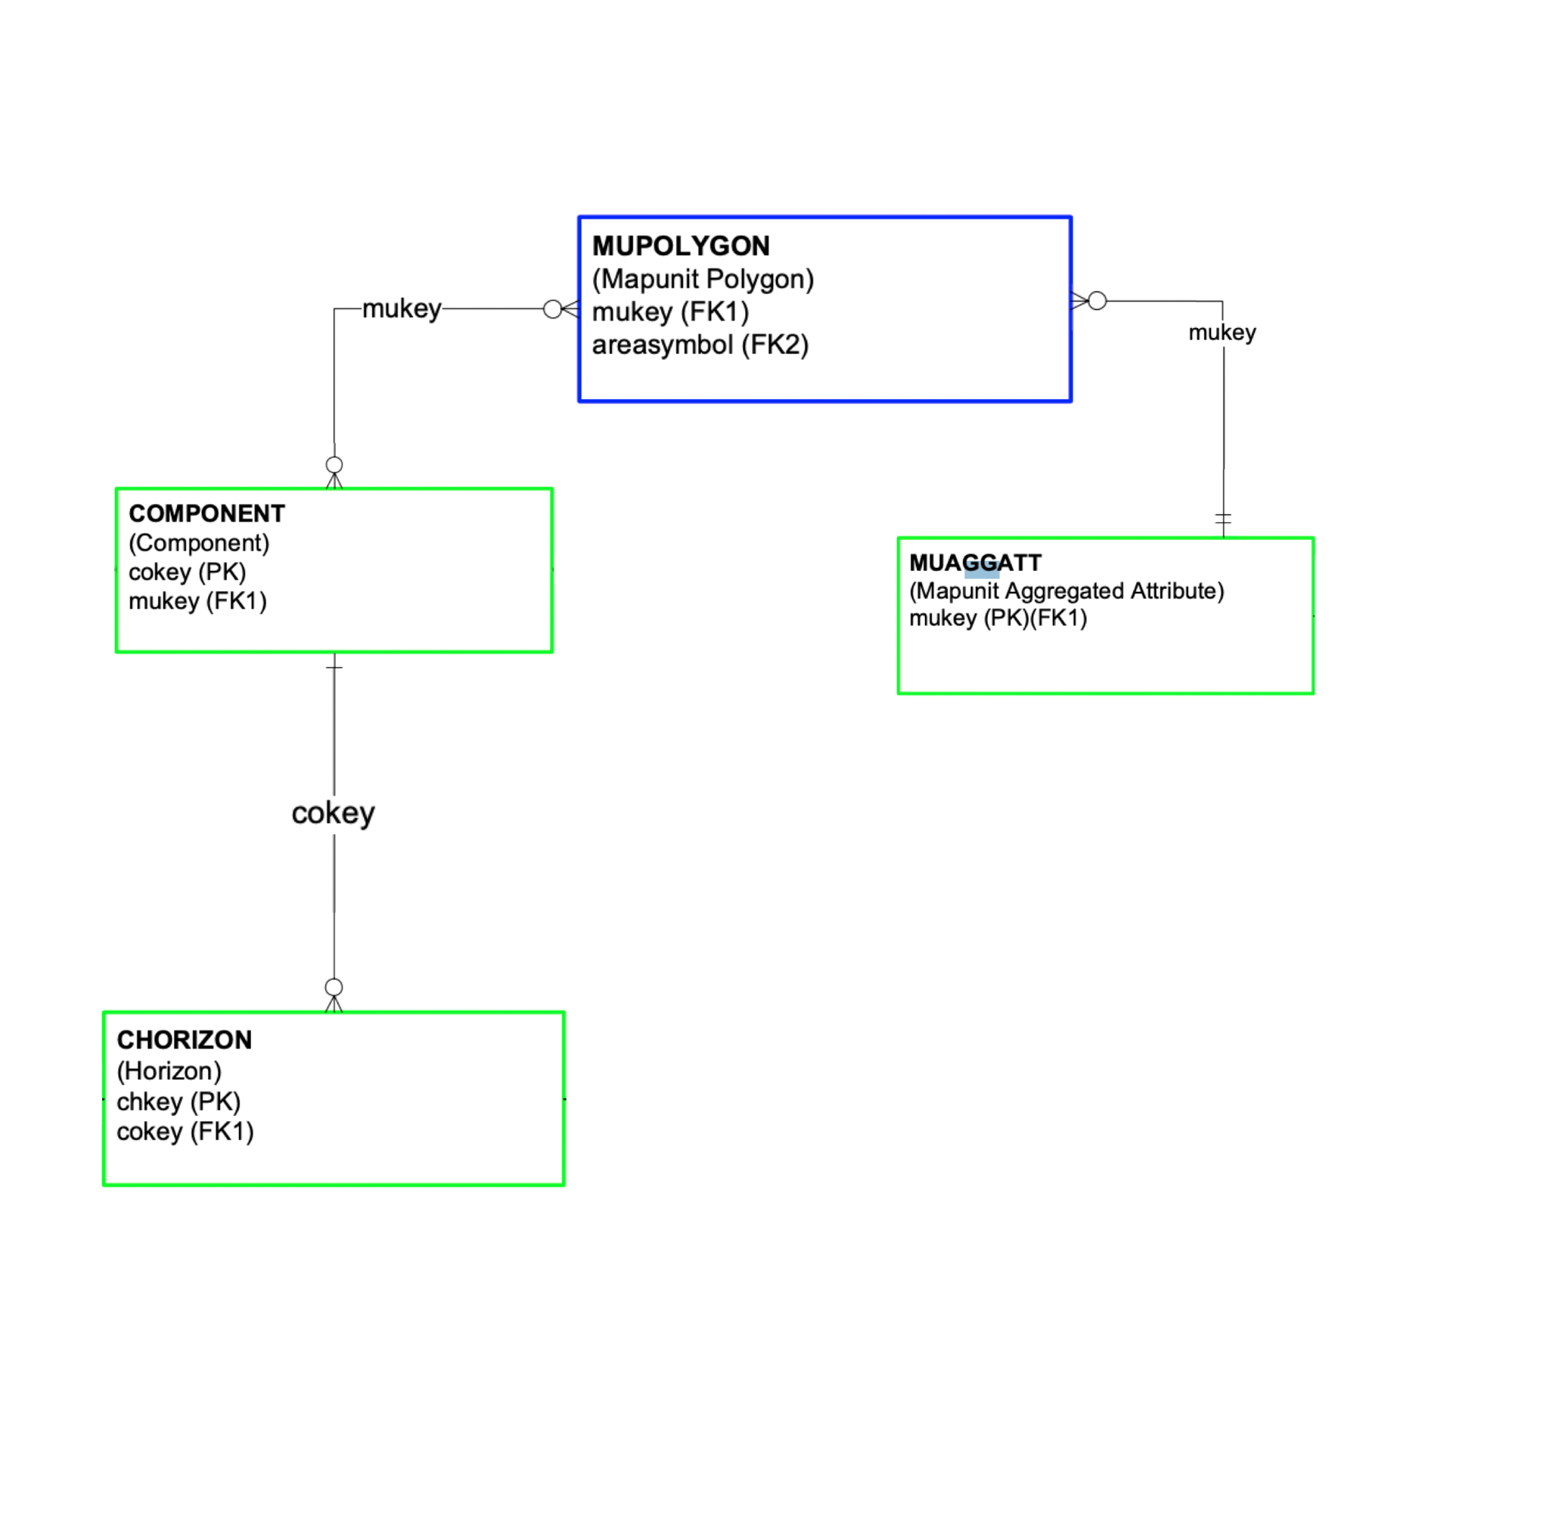
SSURGO Data Structure
MapUnit Polygon : Component = 1:Many relationship
Component : Horizon = 1:Many relationship

Slide 9
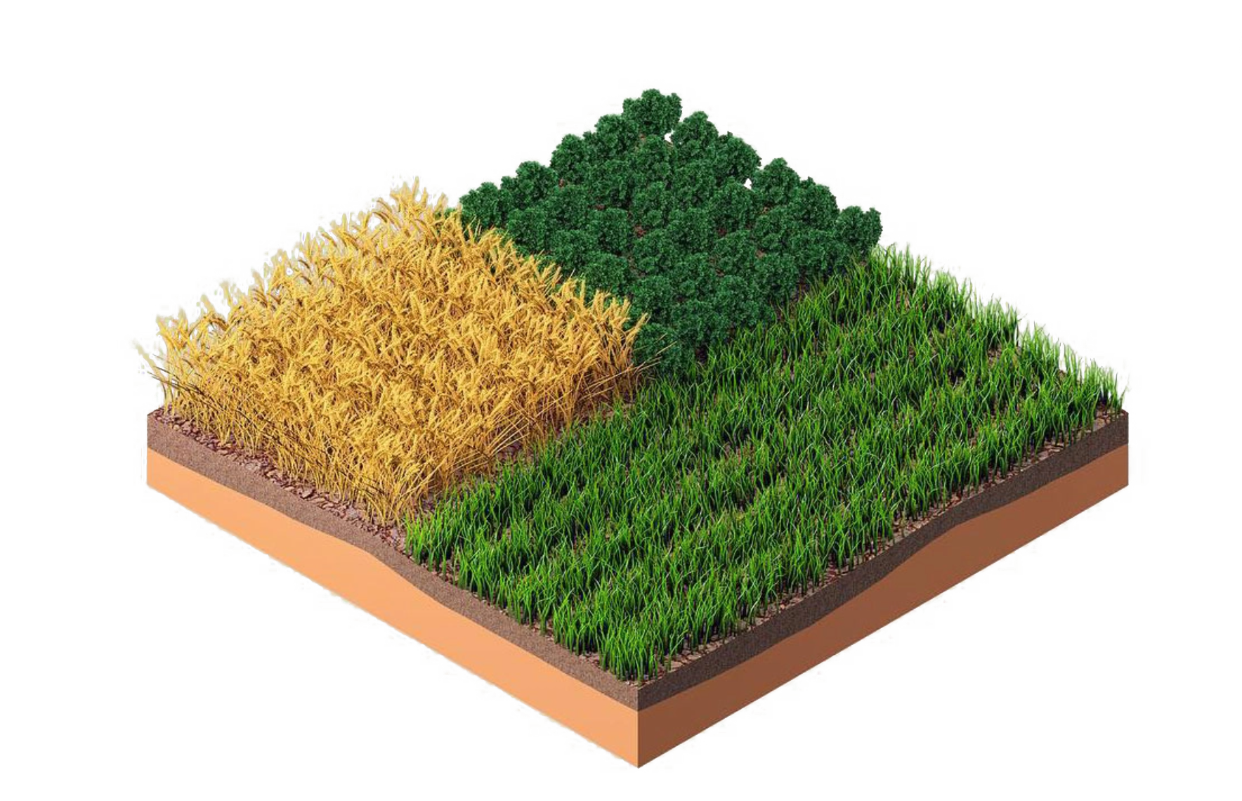
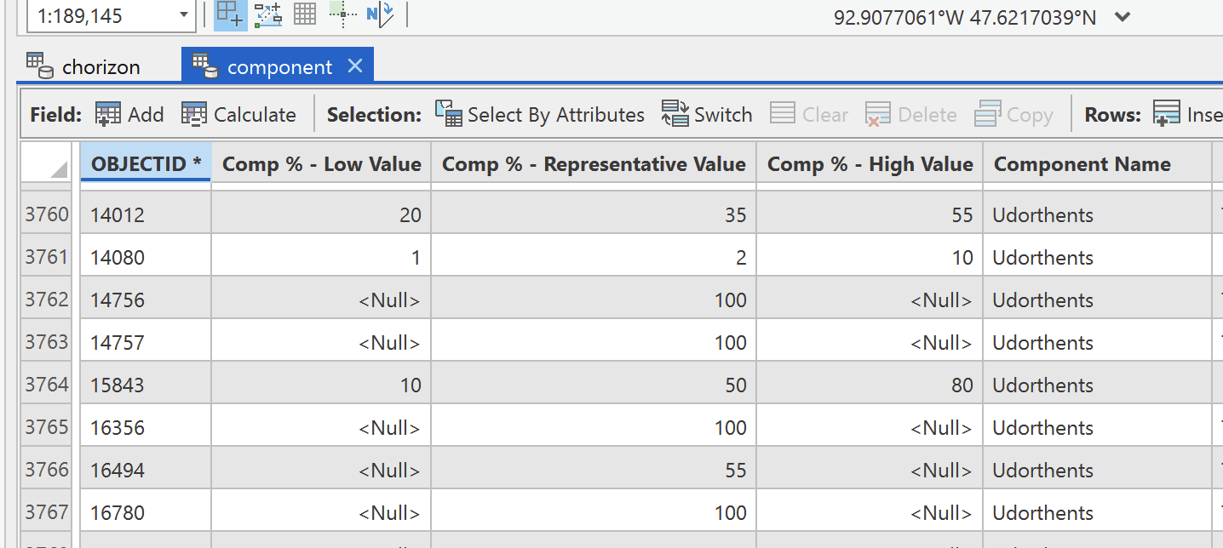
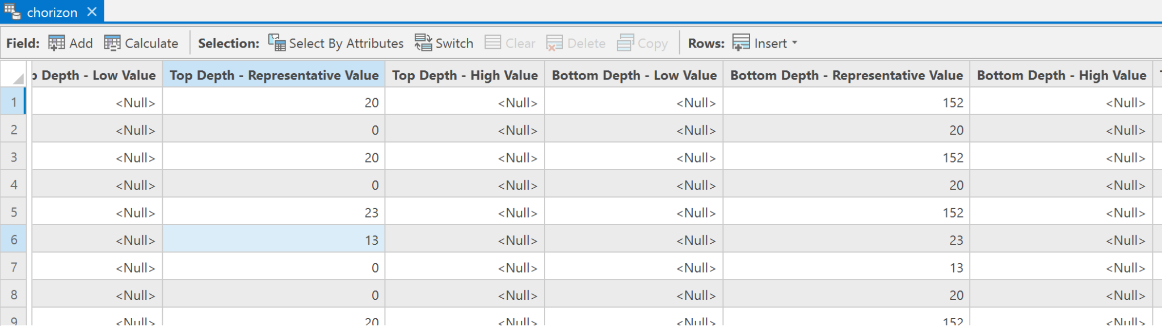
Project Overview: Irrigation Management Assistant Tool
Moving from:
to:
SSURGO input data tables
Field-level soil water holding capacity
?

Slide 10
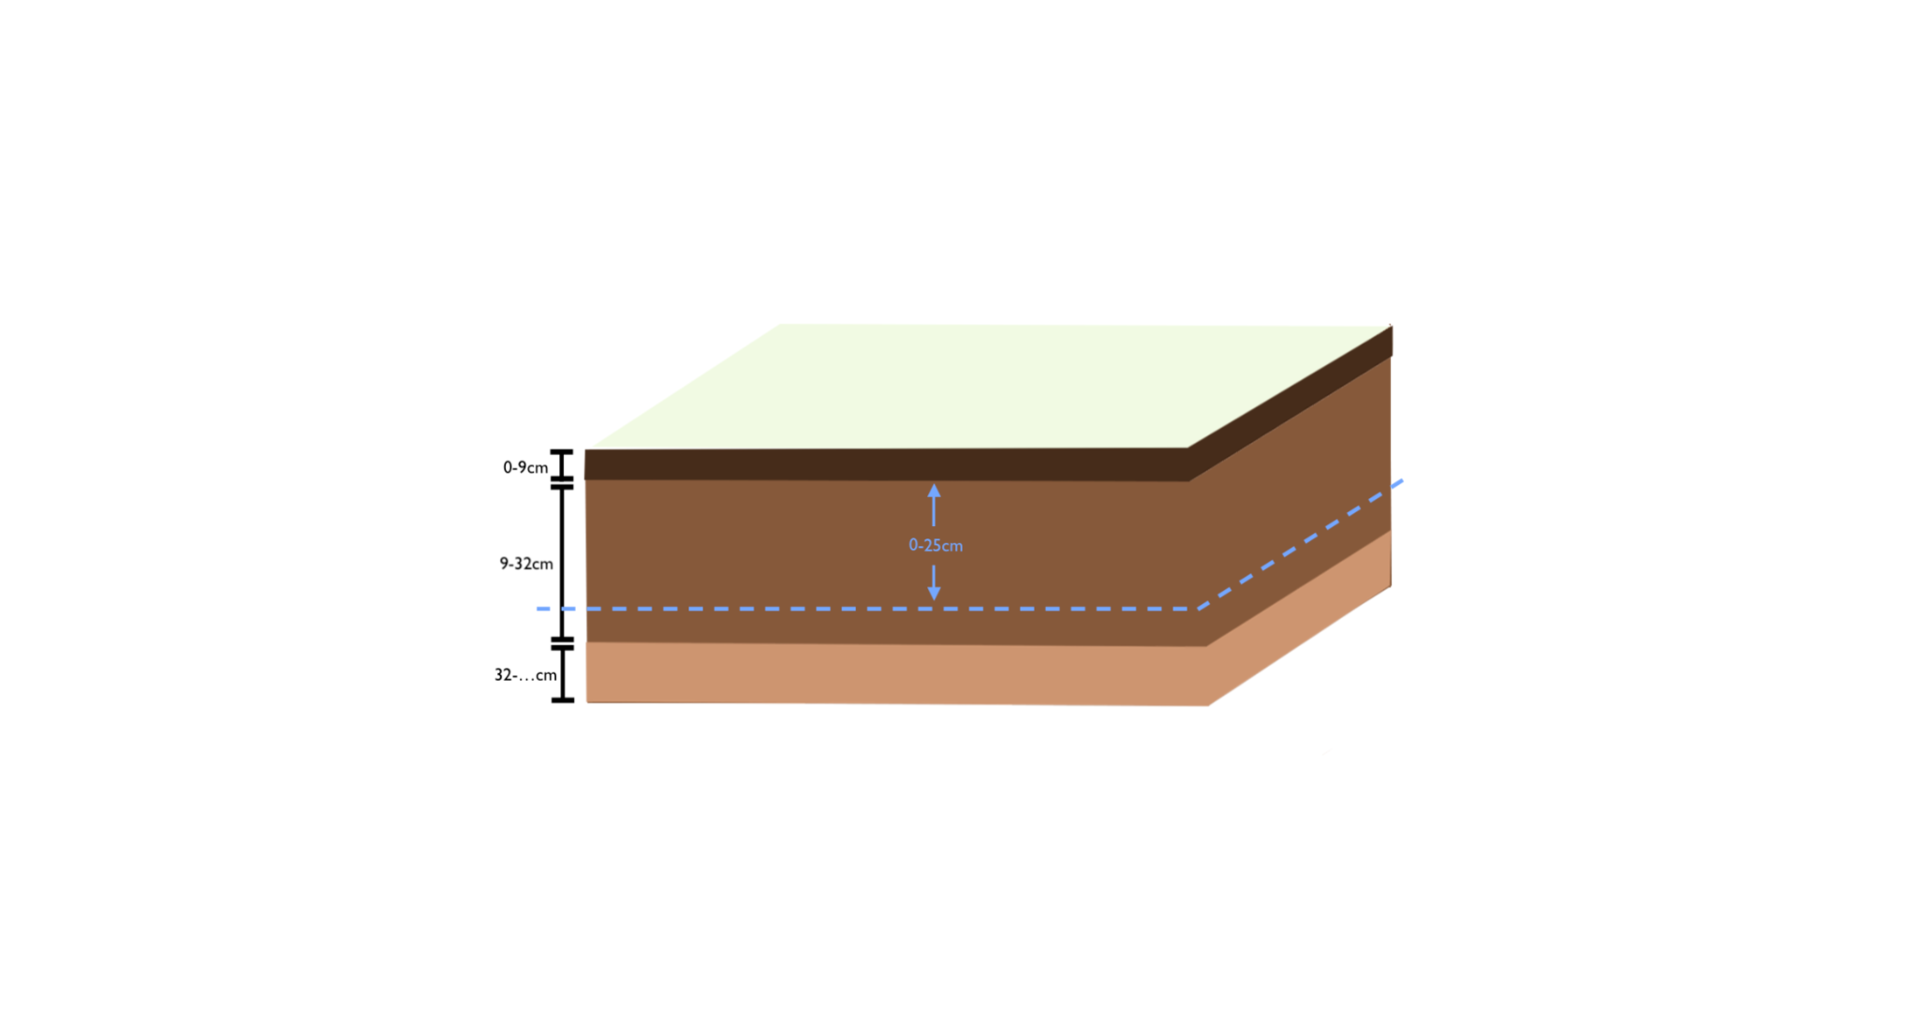
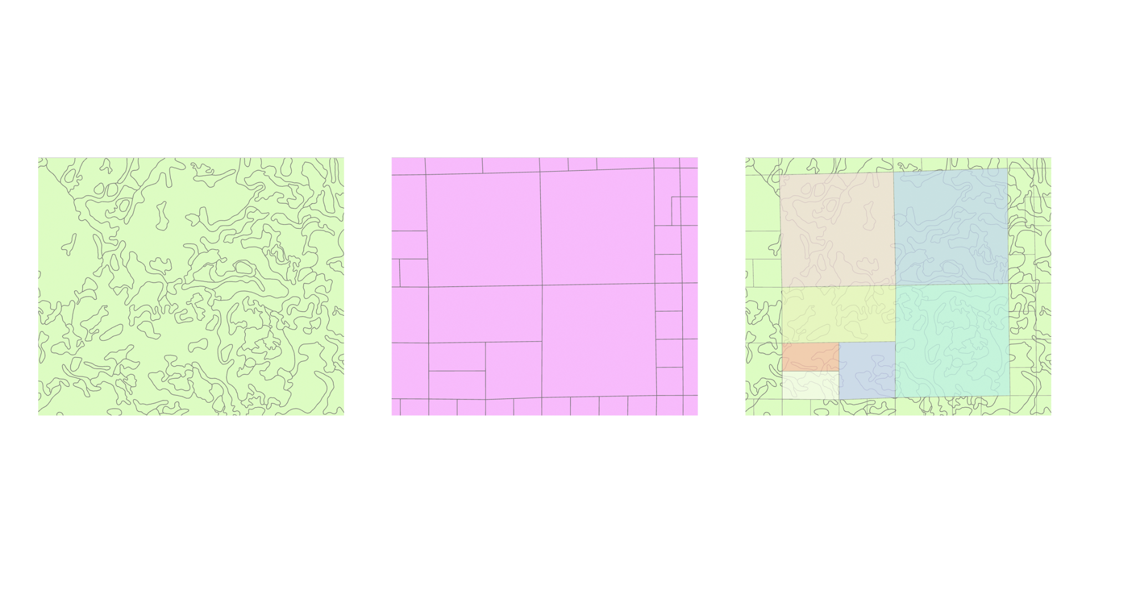
Main Research Objectives
Objective 1. Determine how SSURGO summarizes map unit Available Water Storage (AWS) at their four reported depth intervals (0-25cm, 0-50cm, 0-100cm, 0-150cm); apply method to depth intervals of 0-12in, 12-24in, 24-36in, 36-48in
AWC_{X1-X2}
Objective 2.
Characterize variability between spatial summarization methods (Area Weighted Average; IDW; heuristics) for estimating field-level AWS from map-unit-level AWS

Slide 11
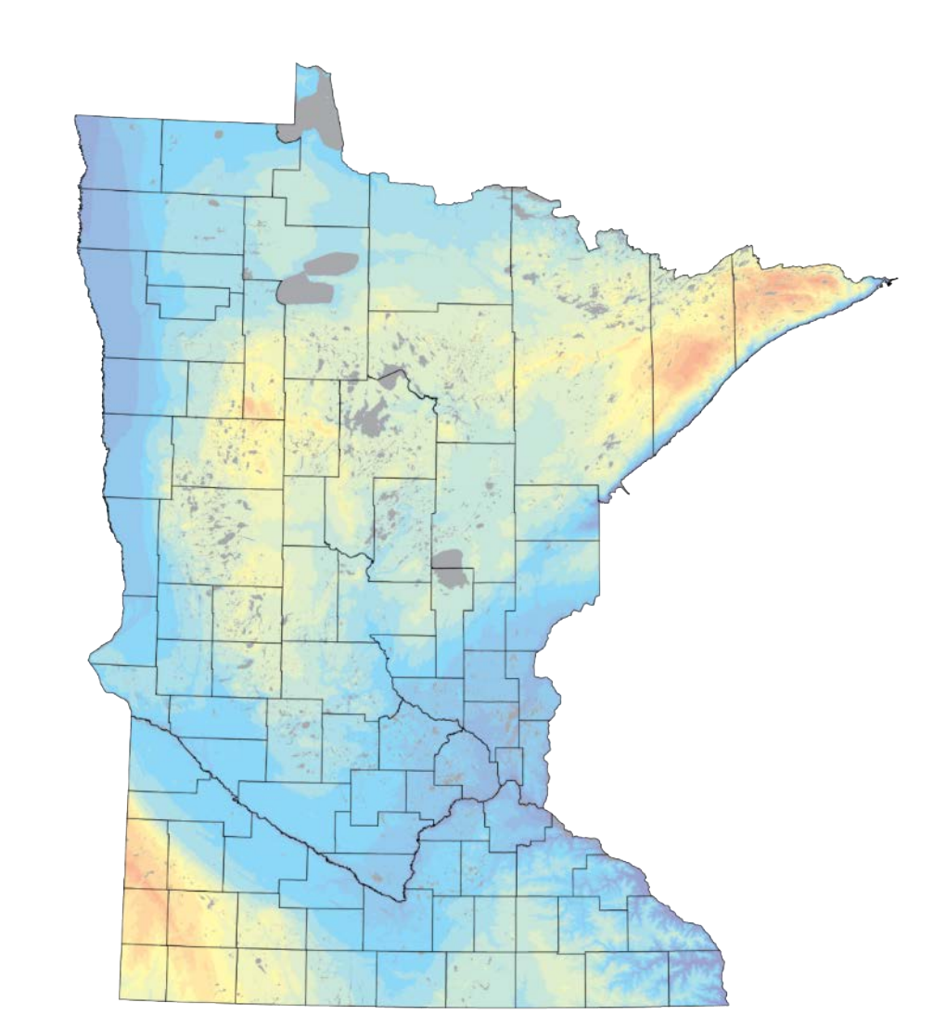
Expected Outcomes
AWS estimates (min and max)
Objective 1.
0-12in
12-24in
24-36in
36-48in
Objective 2.
Amount of Variance between methods
Parcel ID | IDW AWS | Area Weighted AWS | <Heuristic> AWS | Parcel Size (acres)
1 | … | … | … | …
2 | … | … | … | …
3 | … | … | … | …
Parcel ID | IDW AWS | Area Weighted AWS | <Heuristic> AWS | Parcel Size (acres)
1 | … | … | … | …
2 | … | … | … | …
3 | … | … | … | …
. . .
0-25cm
0-50cm

Slide 12
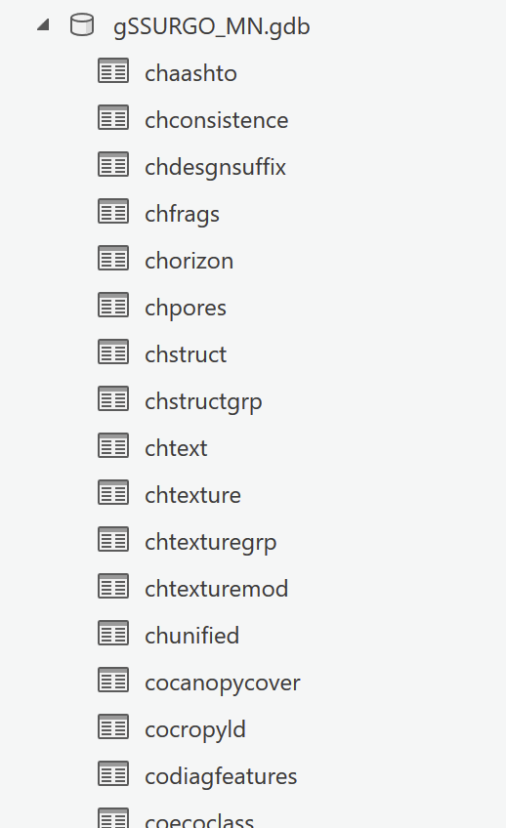
Objective 1. Input Data
‘‘CHORIZON’ table within gSSURGO
“COMPONENT” table within gSSURGO
(“MUGGATT” table within gSSURGO)

Slide 13
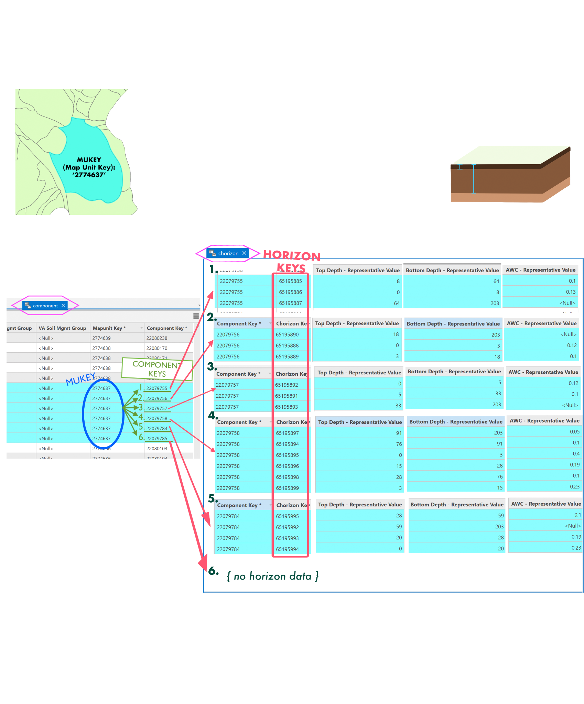
Objective 1. Input Data

Slide 15
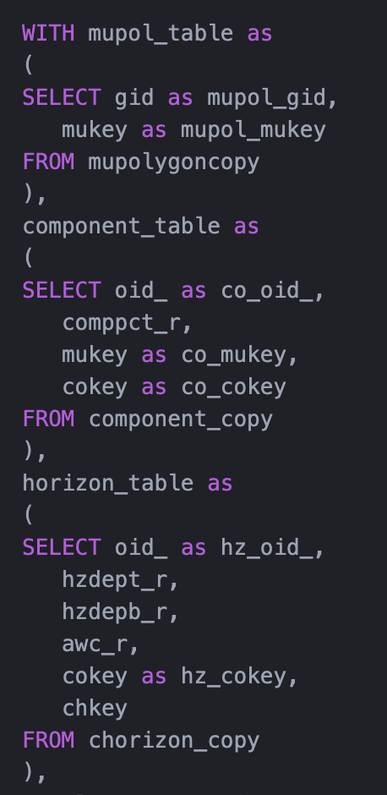
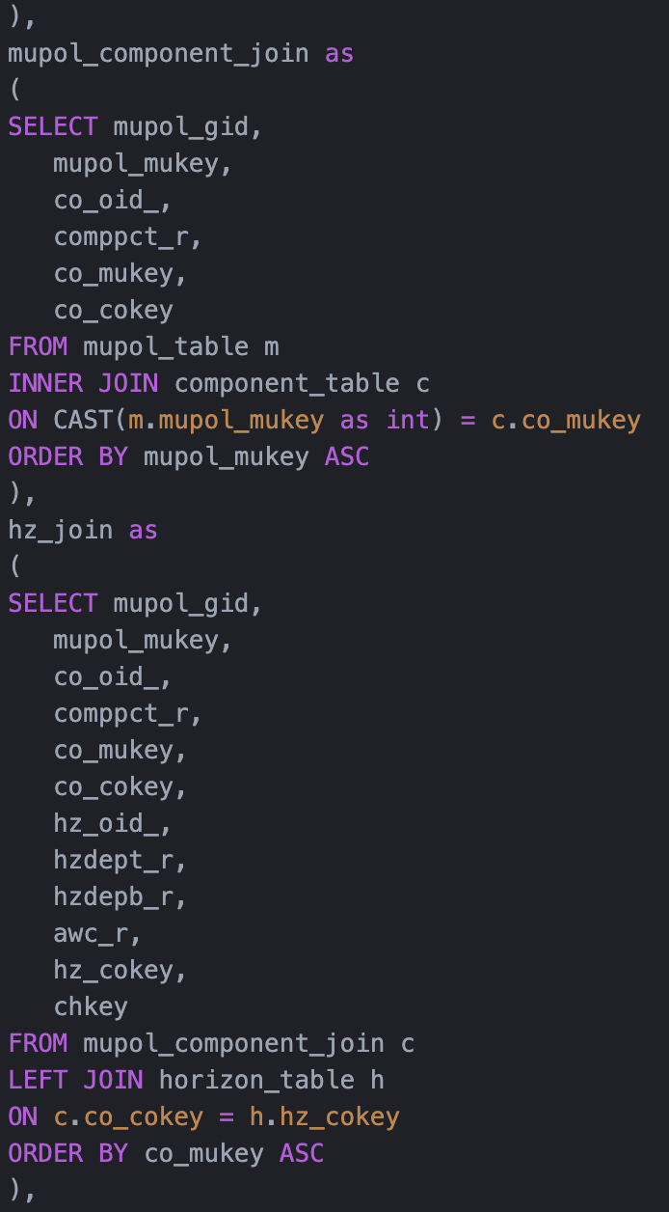
Joining SSURGO Data Tables
Map Unit Polygons
One::Many on “MUKEY
One::Many
Components
One::Many on “COKEY”
Horizons

Slide 16
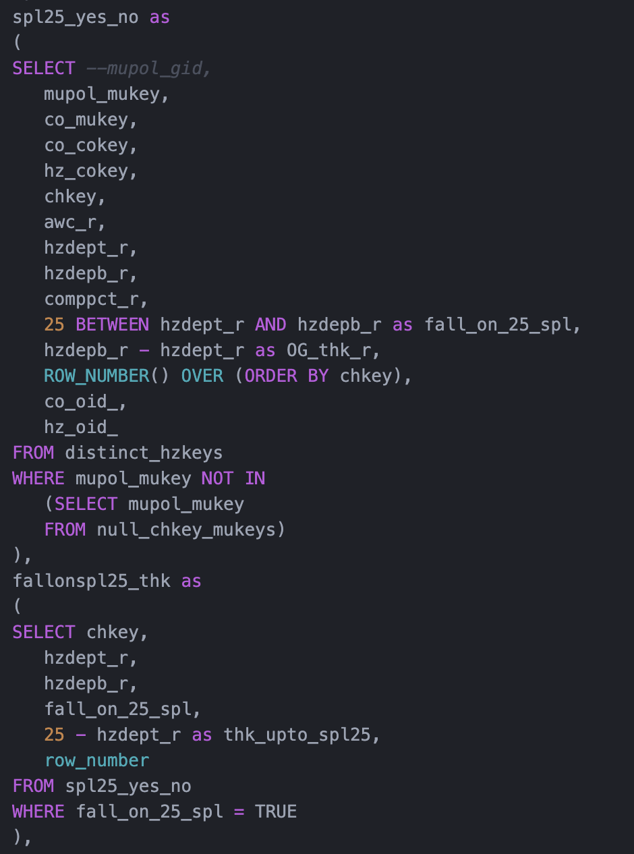
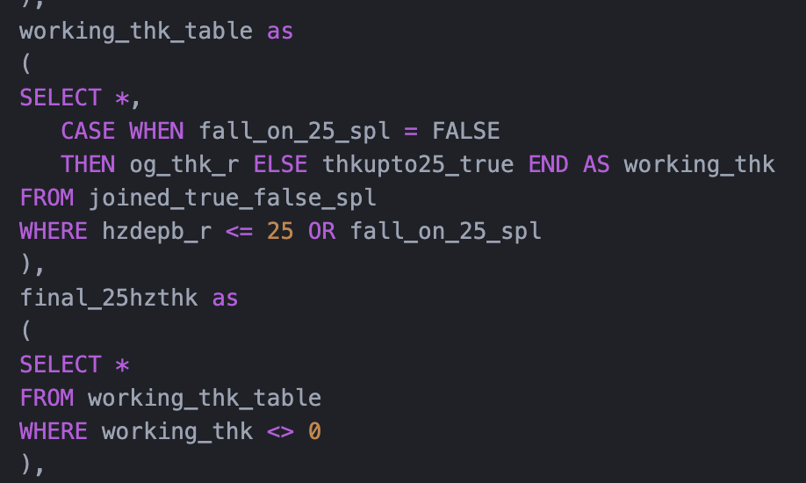
(Capturing correct thickness of horizons which fall on bottom edge of depth interval)

Slide 17
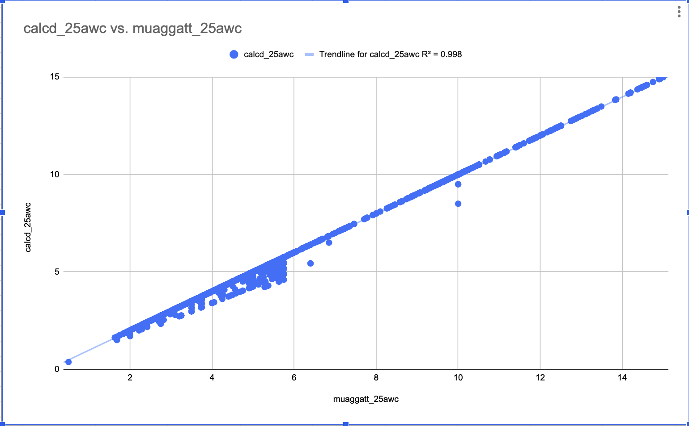
Objective 1. Outcomes
Correlation between script-calculated and SSURGO’s pre-aggregated AWC values at 0-25cm soil depth
R² = .998
Script-calculated
Pre-aggregated values

Slide 18
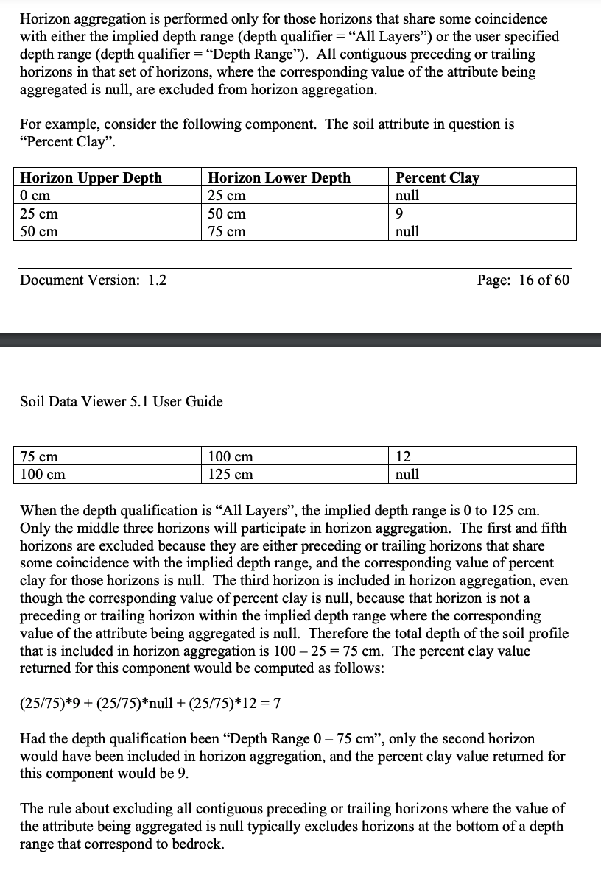

Slide 19
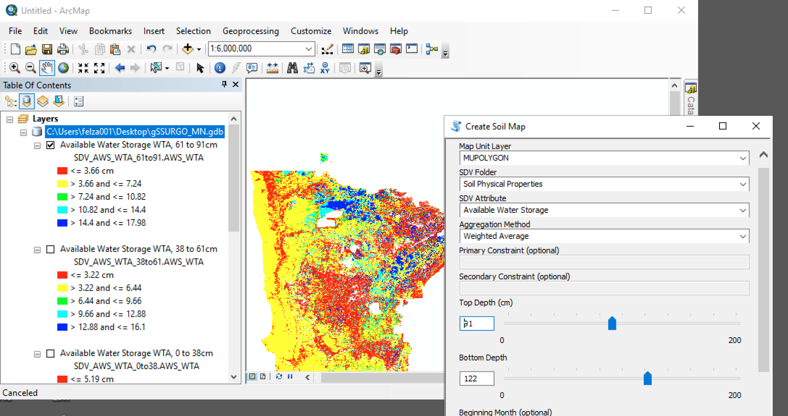
SSURGO’s Create Soil Map Tool

Slide 20
Four Depth Intervals in Question:
Inches | Centimeters
0in - 12in | 0cm - 38cm
12in - 24in | 38cm - 61cm
24in - 36in | 61cm - 91cm
36in - 48in | 91cm - 122cm

Slide 21
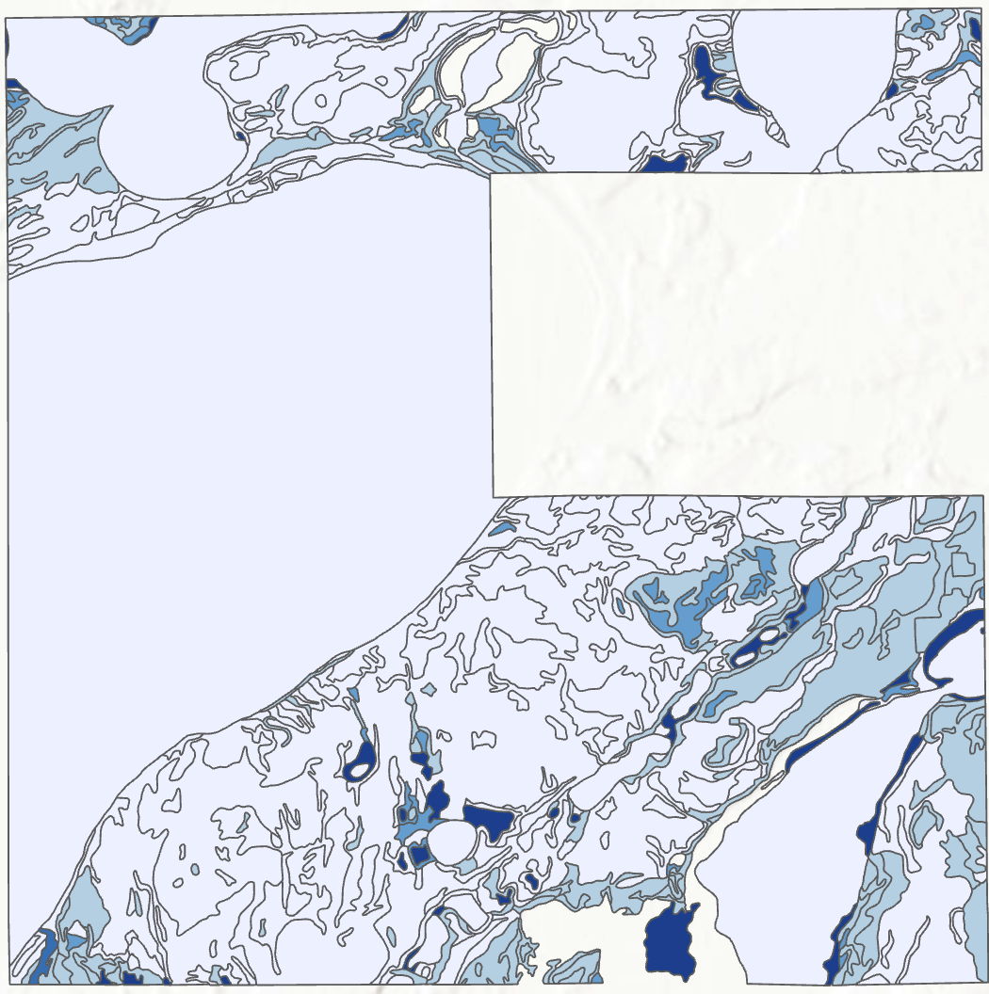
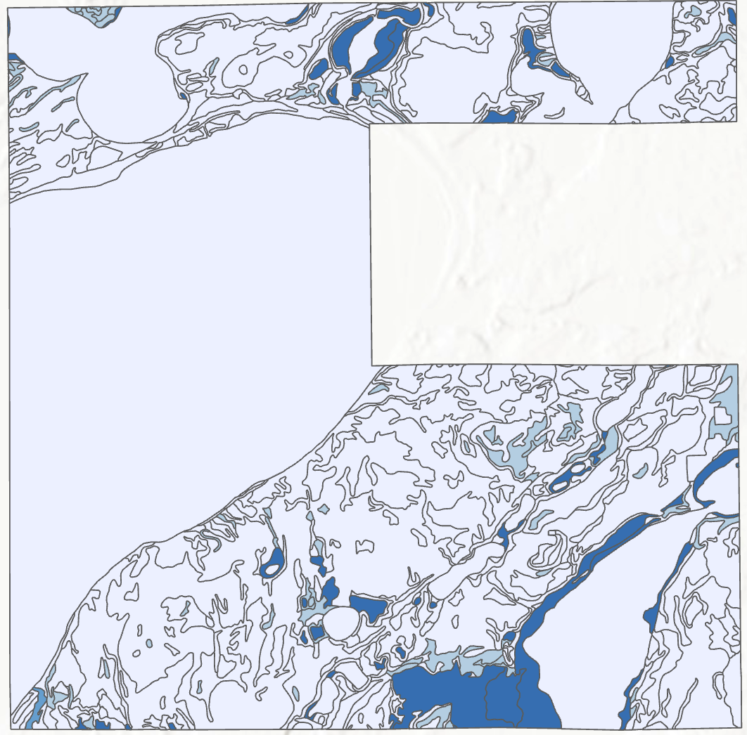
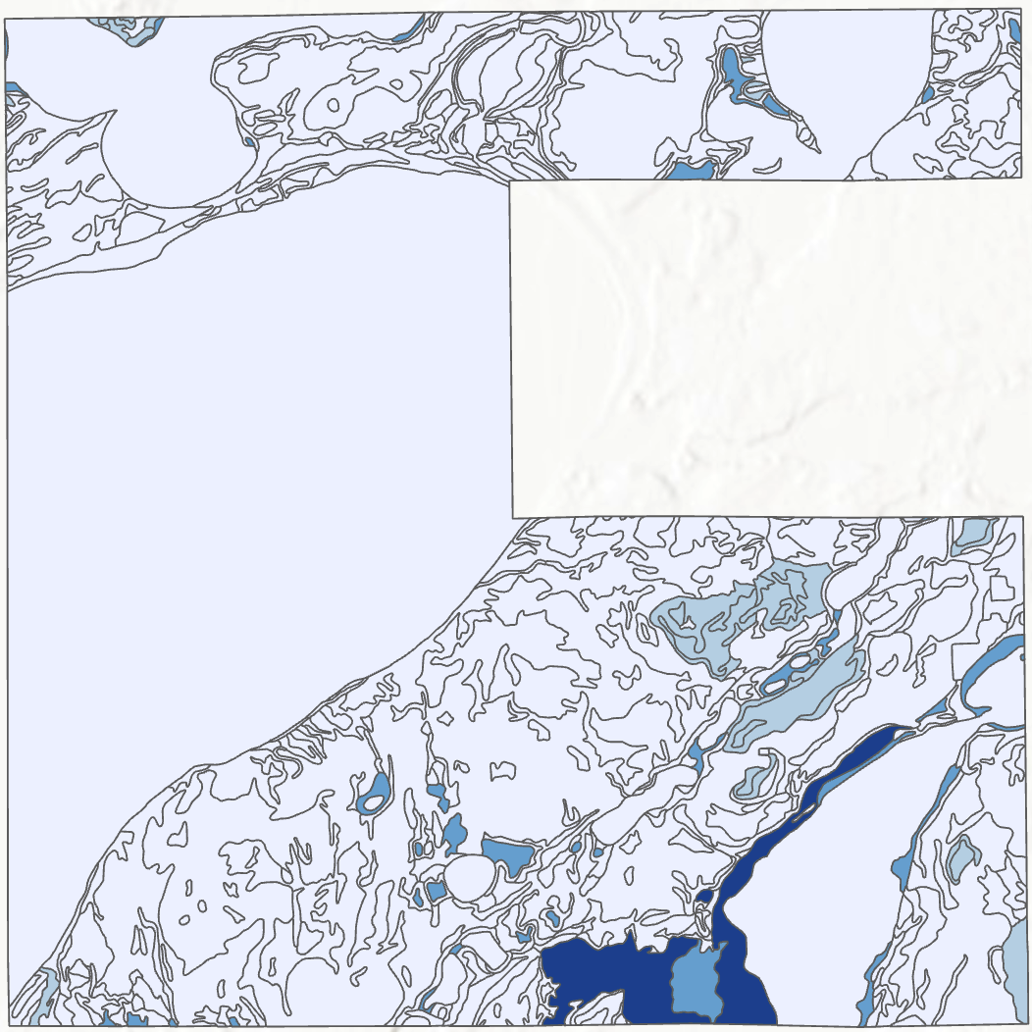
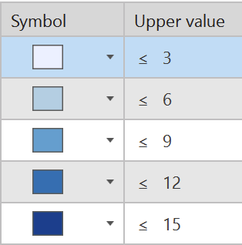
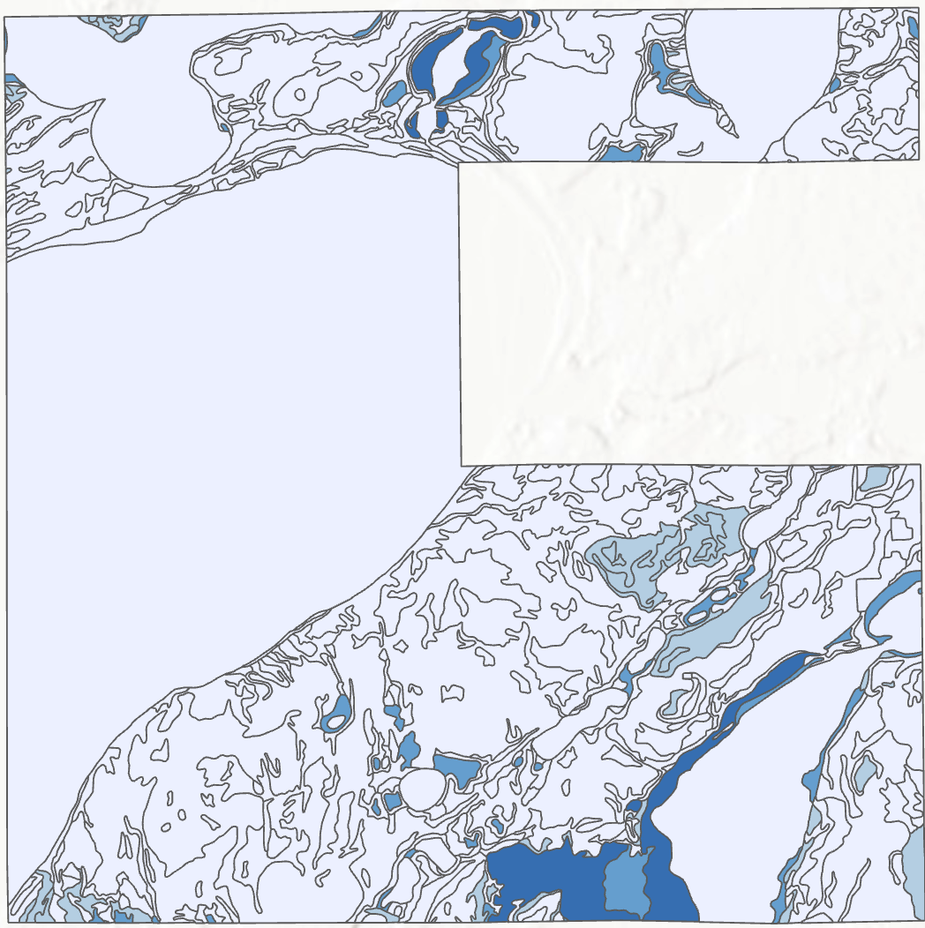
Available Water Storage at Four Depth Intervals (Ottertail County)
AWS
0cm - 38cm
AWS
38cm - 61cm
AWS
61cm - 91cm
AWS
91cm - 122cm

Slide 23
Objective 2. Expected Outcomes
0-25cm soil depth
0-50cm soil depth
Understanding how different algorithms for summarizing MUkey polygons to parcel geometries vary AWS calculations
Understanding role of spatial variation within parcels in these categories
Understanding how these calculations may be influenced by soil depth interval.
 | IDW | AWA | (Heur-istic) | Parcel Size (acres)
Parcel 1 AWS | 4.55 | 6.82 | 4.71 | 220
Parcel 2 AWS | 3.45 | 4.55 | 8.90 | 3000
… | 6.811 | 7.9 | 4.32 | 610
 | IDW | AWA | (Heur-istic) | Parcel Size (acres)
Parcel 1 AWS | 2.75 | 4.36 | 5.62 | 160
Parcel 2 AWS | 4.1 | 5.24 | 4.39 | 2880
… | 6.31 | 8.9 | 7.94 | 520
Total variance
between algorithms =
Total variance within algorithm/size categories caused by variations in
depth =
Total variance within categories from spatial variation in plot size=

Slide 24
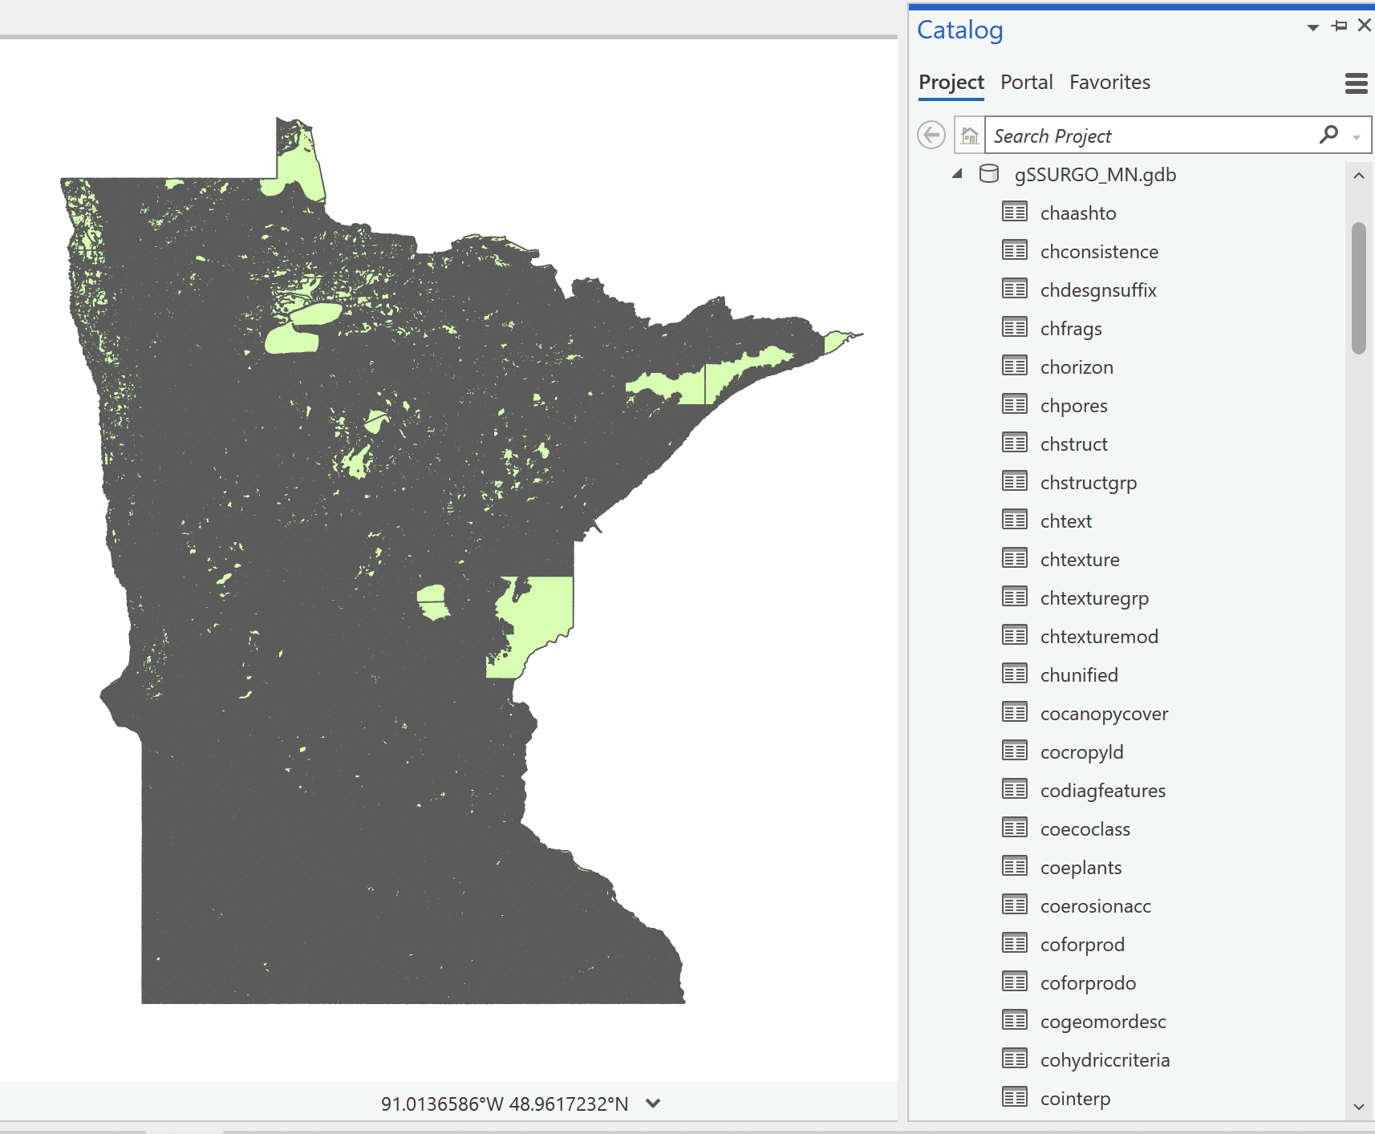
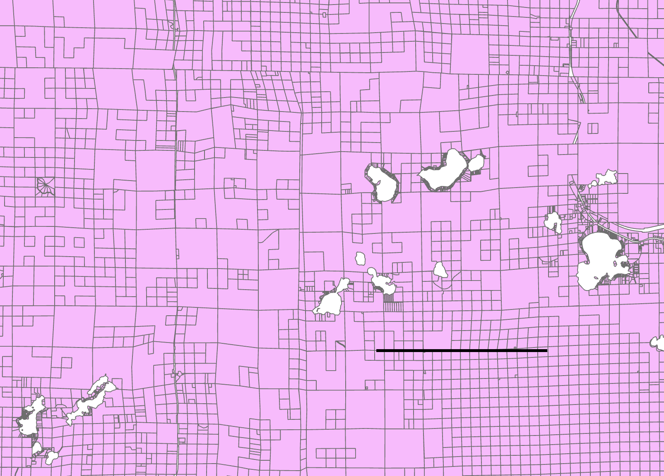
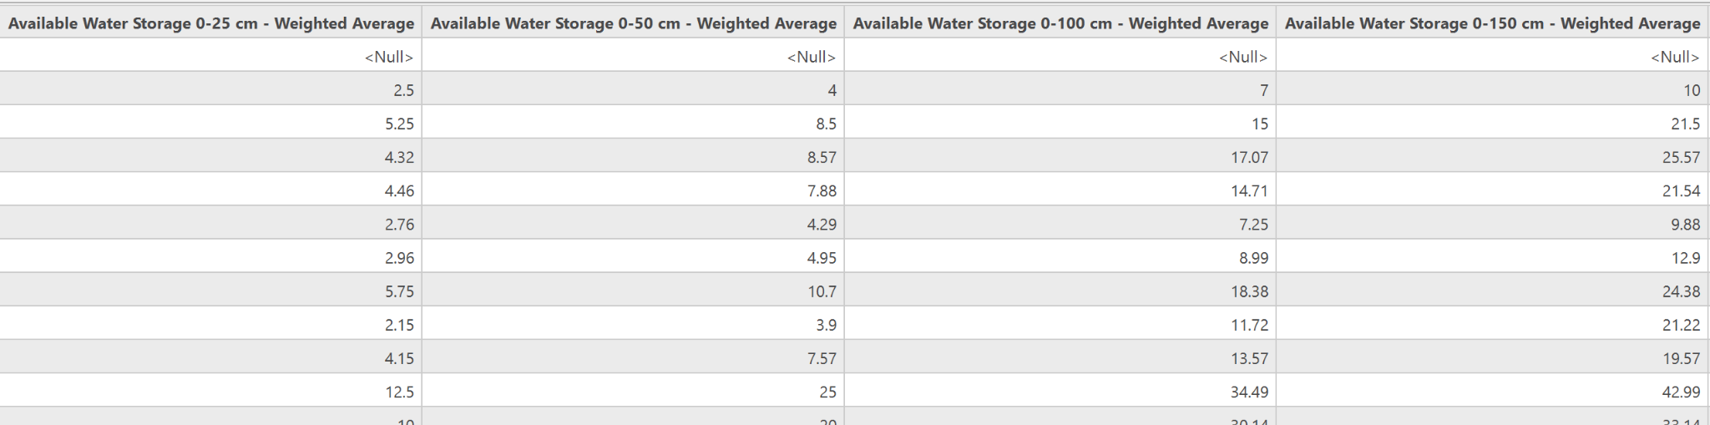
Objective 2. Input Data
gSSURGO dataset – Available Water Storage 0-25cm; 0-50cm; 0-100cm; 0-150cm (‘MUGGATT’ table)
MN (Statewide) County Parcel Dataset
10km

Slide 25
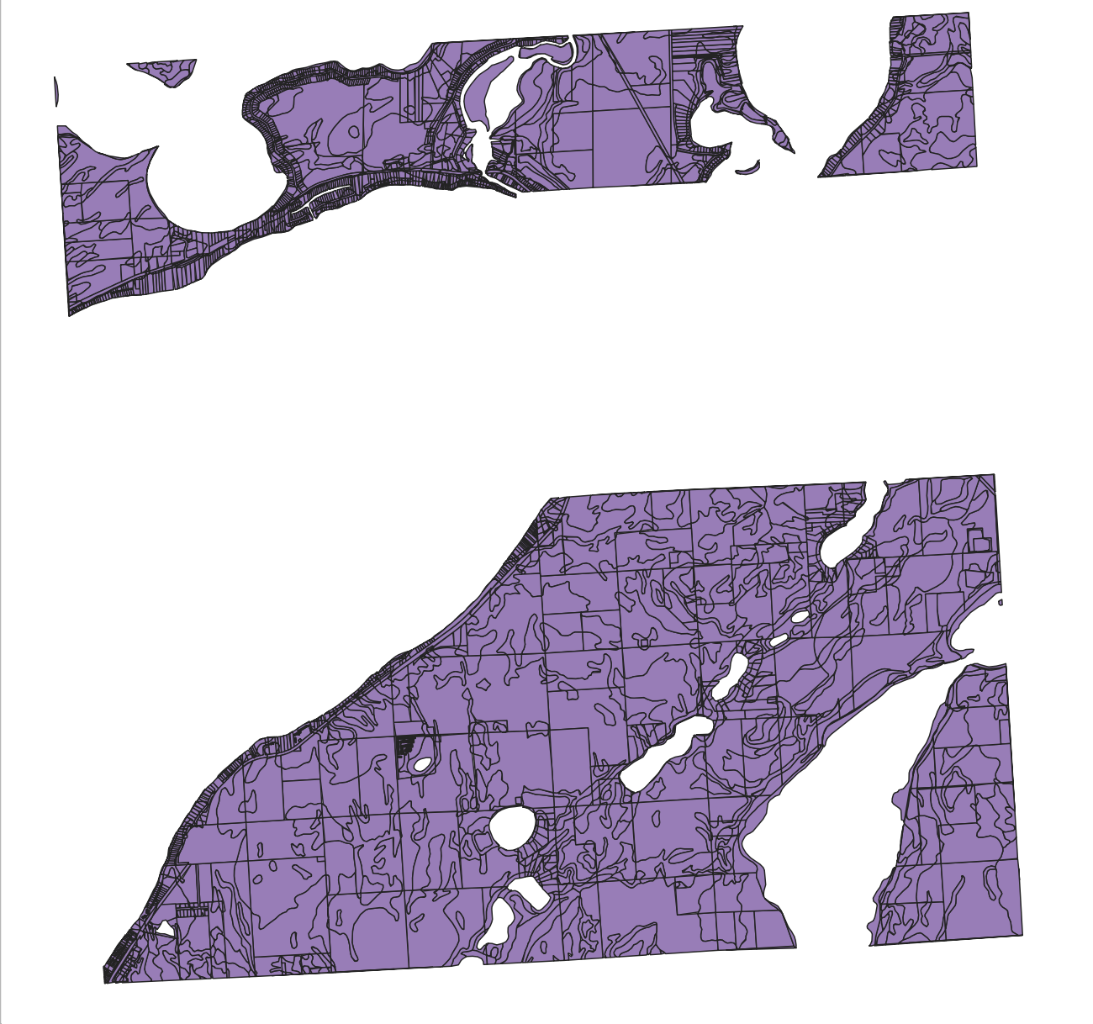
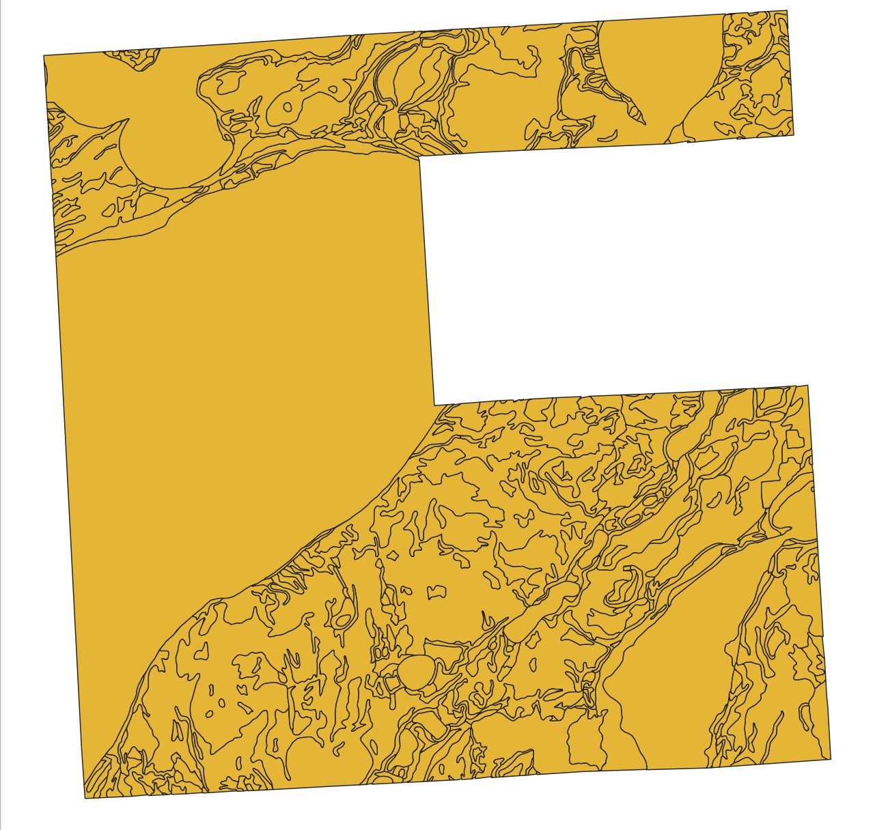
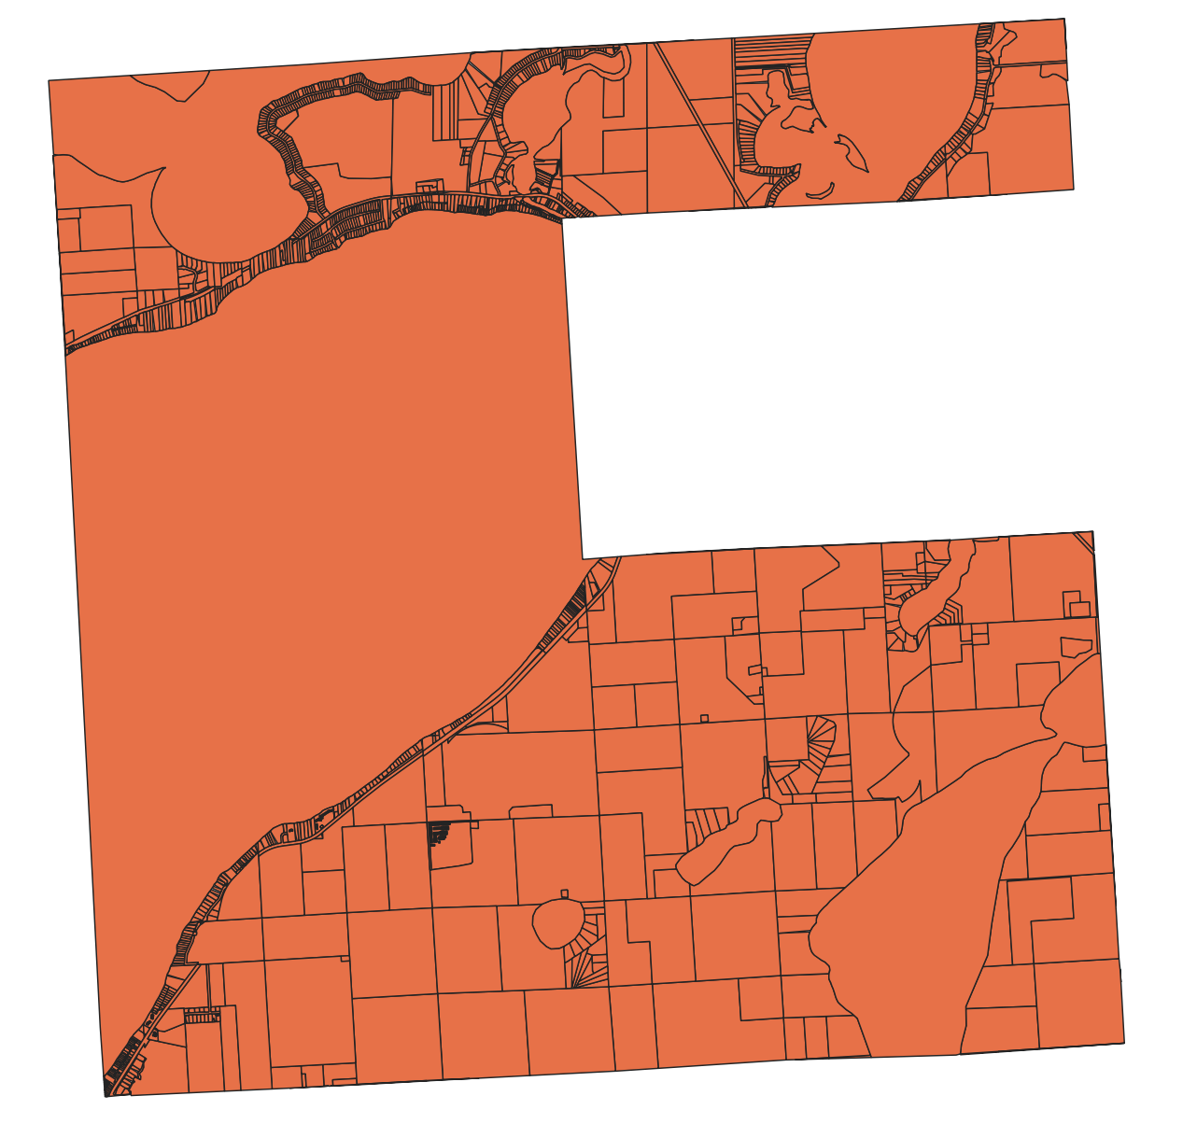
Objective 2. Methodology
∩
=

Slide 26
∩
=

Slide 27
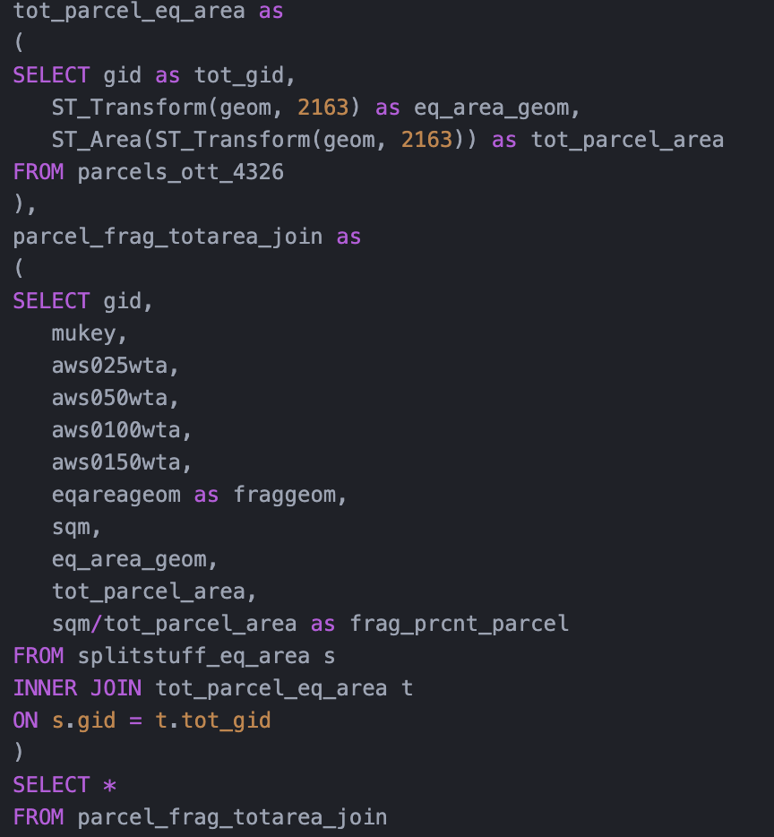
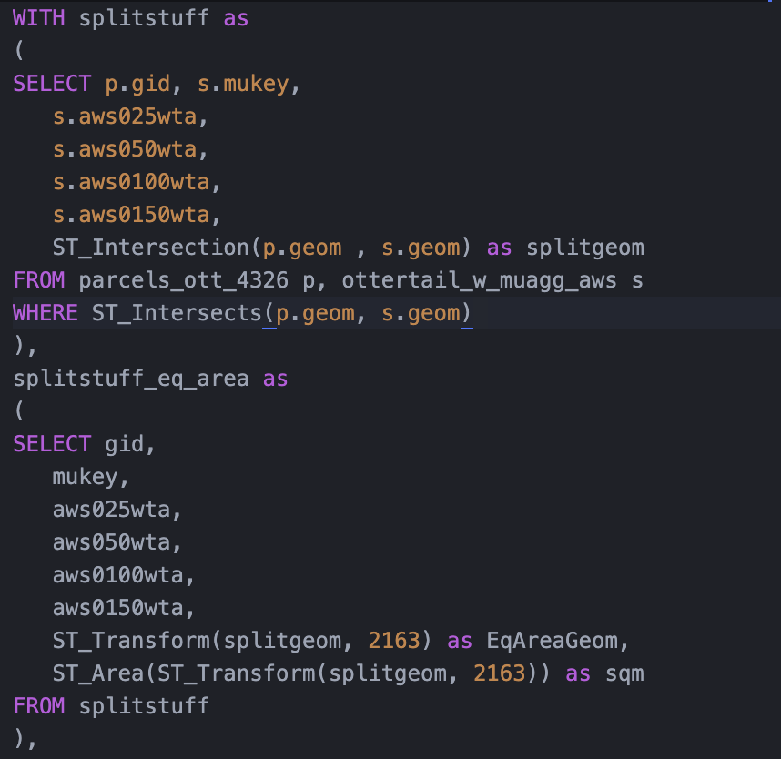

Slide 28
Objective 2. Heuristics
If soil type takes up > 80% of parcel, just use that soil type’s AWS for parcel
If soil type takes up < 20% of parcel, throw soil type out

Slide 29
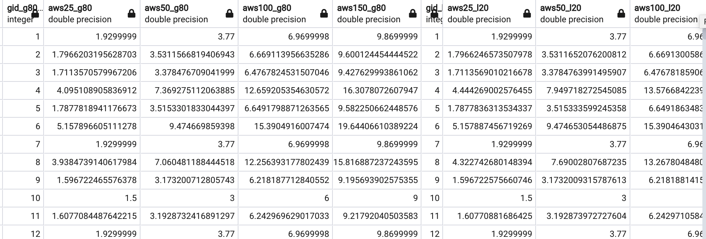
Objective 2. Heuristic AWS Calculation

Slide 30
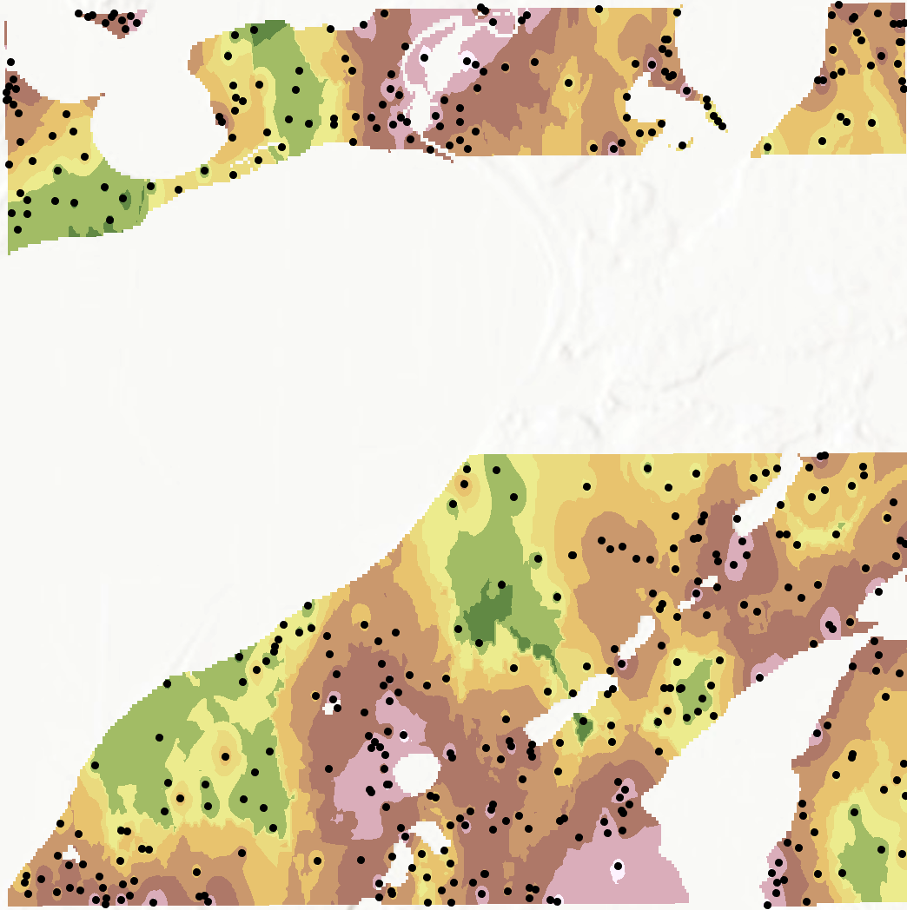
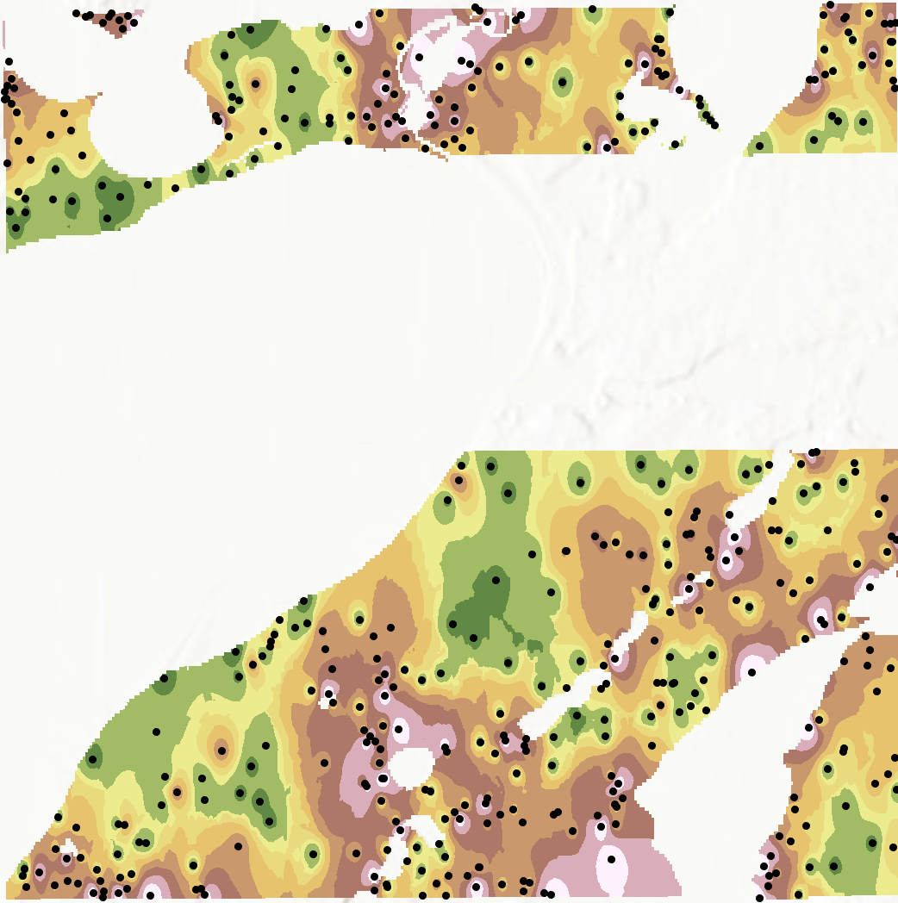
IDW

Slide 31
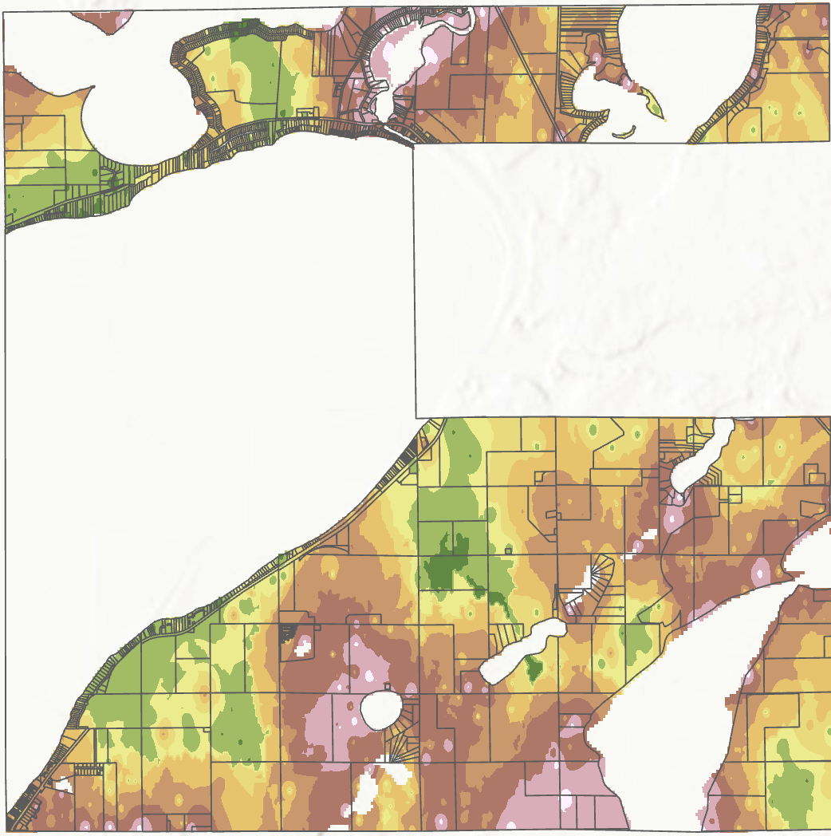
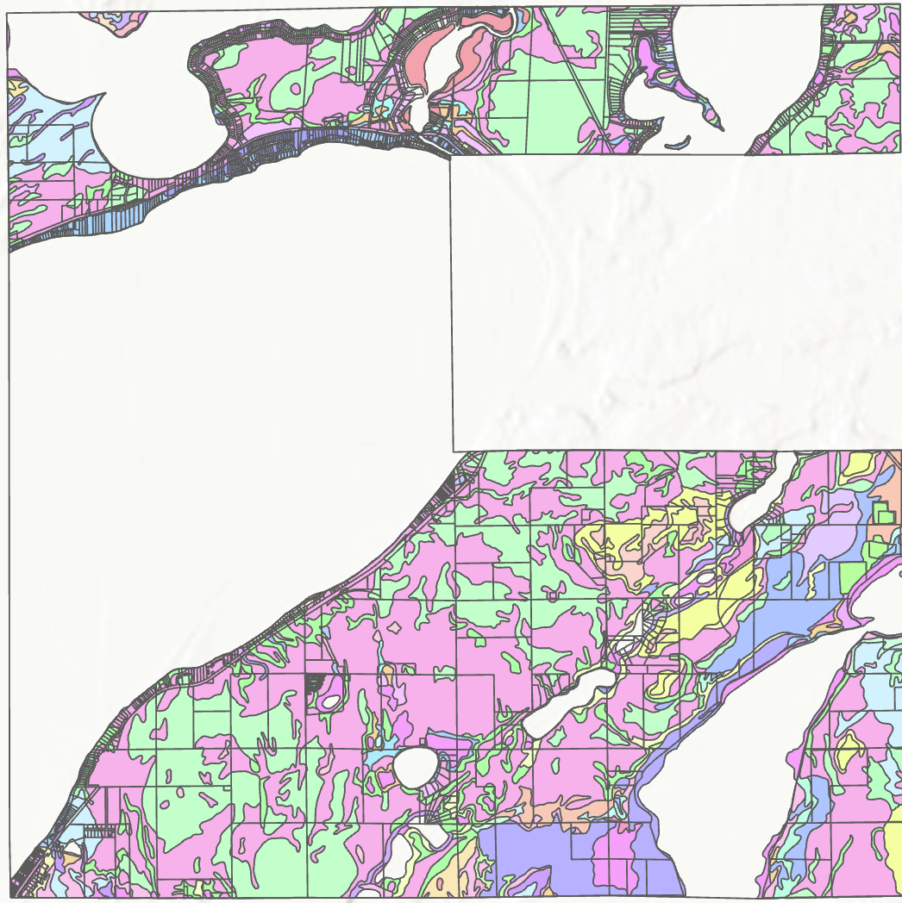
IDW vs. Original Data

